Slide 1

Grade 12
Wishing you all the best

Slide 2
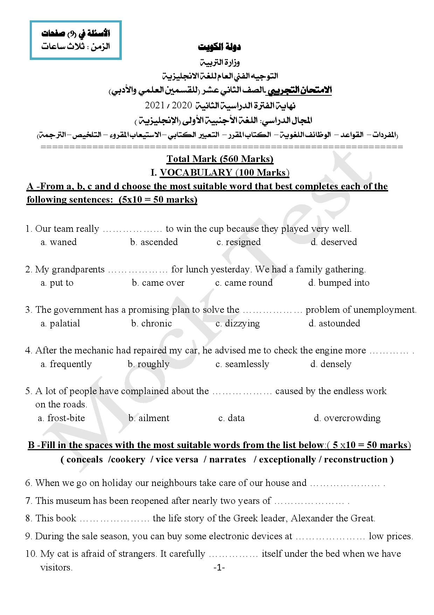

Slide 4
vise versa
reconstruction
narrates
exceptionally
conceals

Slide 5
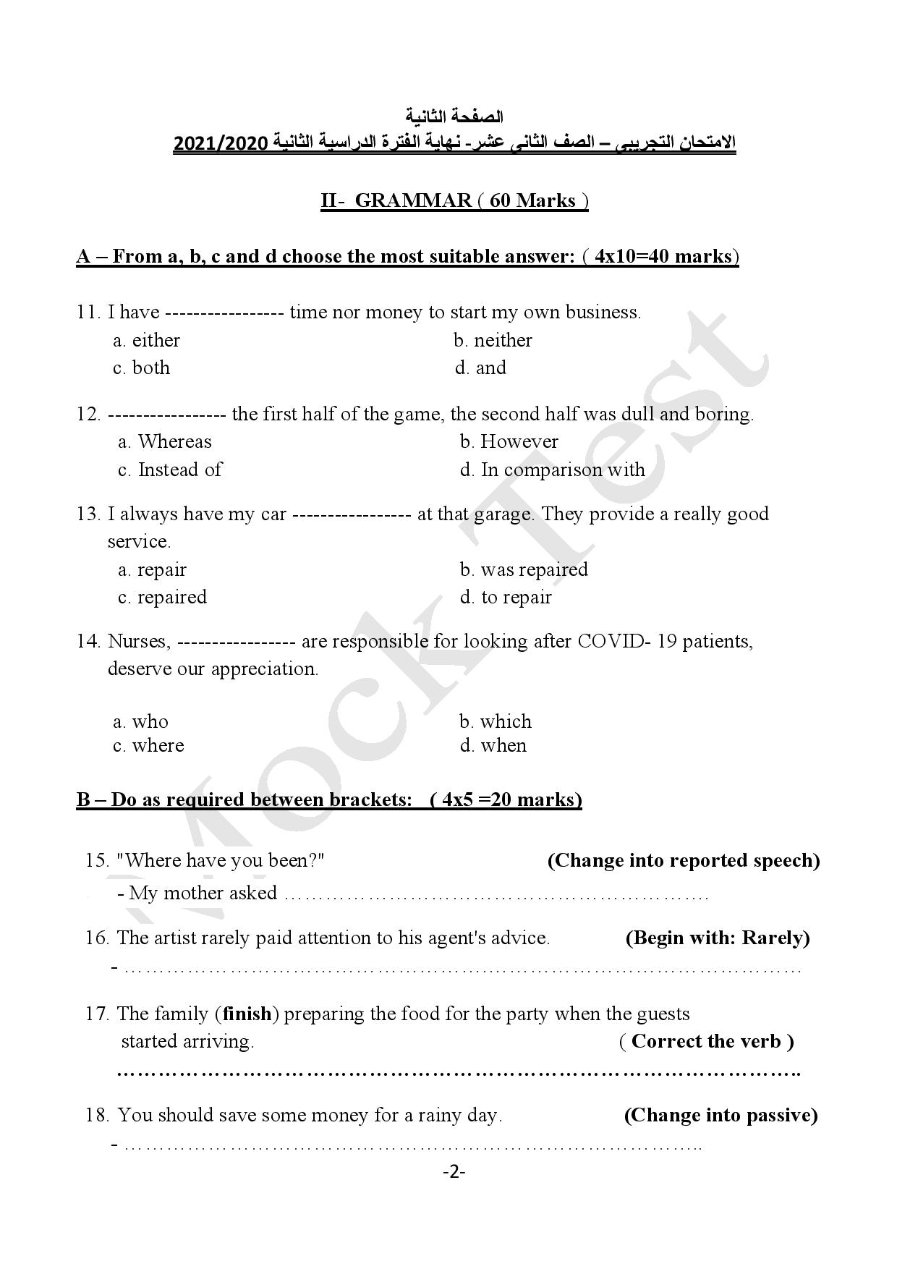

Slide 6
where I had been.
Rarely did the artist pay attention to his agent's advice.
The family had finished preparing the food for the party when the guests started arriving.
Some money should be saved for a rainy day.

Slide 7
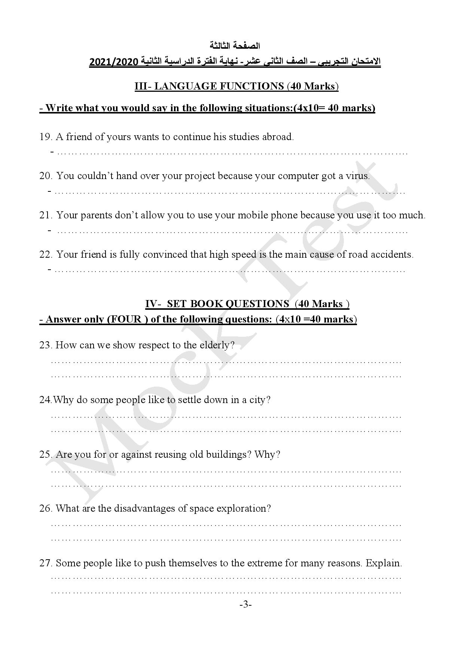
Giving advice: If you do this, you will have to improve your language first.
Giving reasons: I couldn’t hand my project on time because my computer had
got a virus.

Slide 8
Justifying: Please, let me use my mobile phone because I depend mainly on
it in doing my homework and communicating with my friends.
Agreeing: I totally agree with you. Speeding is the main cause of road
accidents.

Slide 9
We can show them respect
By helping them to do simple tasks. By standing when they enter a room.
By holding doors open for them. By listening carefully to their advice.
By lowering your voice when talking to them. By treating them in a friendly way.
By not interrupting them while talking.
Some people like to settle down in a city
To seek better jobs. To enjoy better services.
To enjoy modern & comfortable life. To enjoy better health care.
To enjoy better life conditions. To enjoy better education.
To enjoy fun places.

Slide 10
I am for reusing old buildings because
They attract tourists.
They reflect culture.
They revive heritage.
They have historical value.
It needs a lot of study.
Being away from family for a very long time.
It costs a fortune.
It needs extensive training.
It is a risky job.

Slide 11
To seek fame.
To overcome fears.
To feel superior.
To develop skills.
To set world records.
To gain money.
To be the centre of attention.

Slide 12
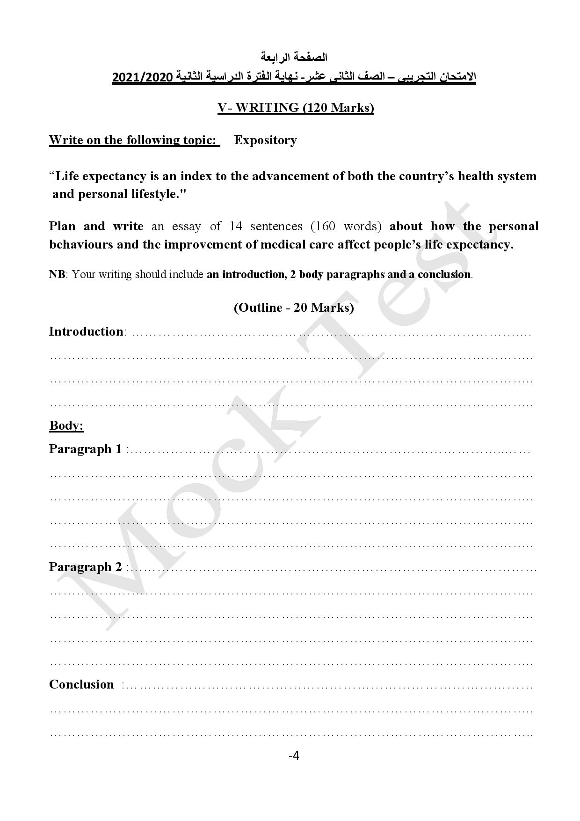

Slide 13
Do you agree that the increase in average life expectancy can be regarded as one of the society’s greatest achievements?
Of course, life expectancy has increased not only because of the improvements in personal behaviours but also due to the revolution in the medical field and health care.
How the personal behaviours affect people’s life expectancy
stop smoking
having enough sleep
taking care of personal hygiene
avoiding fast food
doing sport regularly
following a good diet
having good social life
The improvement of medical care affect people’s life expectancy
modern hospitals and clinics
a rise in the field of surgeries
cures for fatal diseases
large investments in the medical field
revolution in scientific research
To sum up, I think longevity has been increasing over the past century thanks to medical advances and lifestyle improvements. Not only has the average life expectancy increased since 1900, but a larger number of people are living to older ages nowadays.

Slide 14
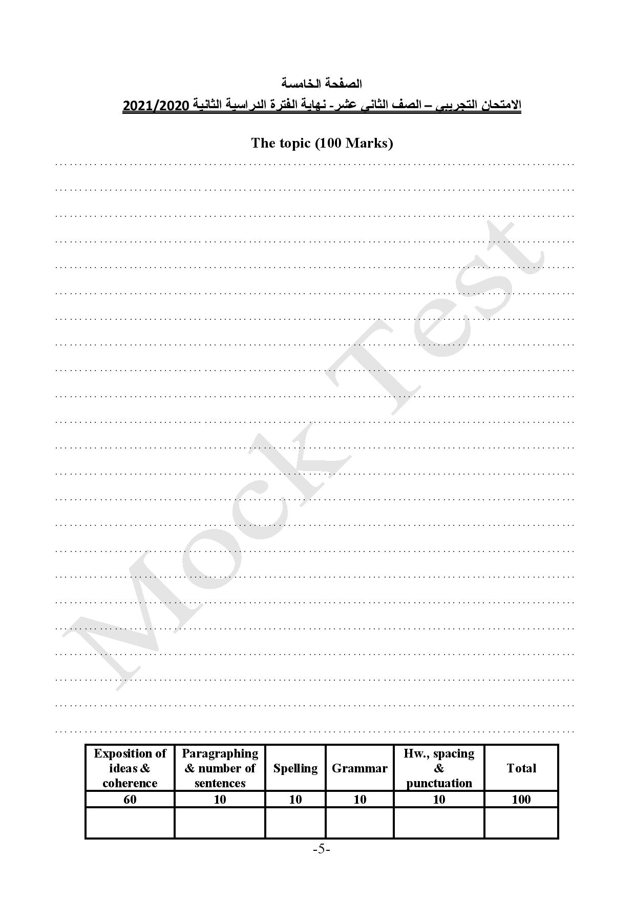

Slide 15
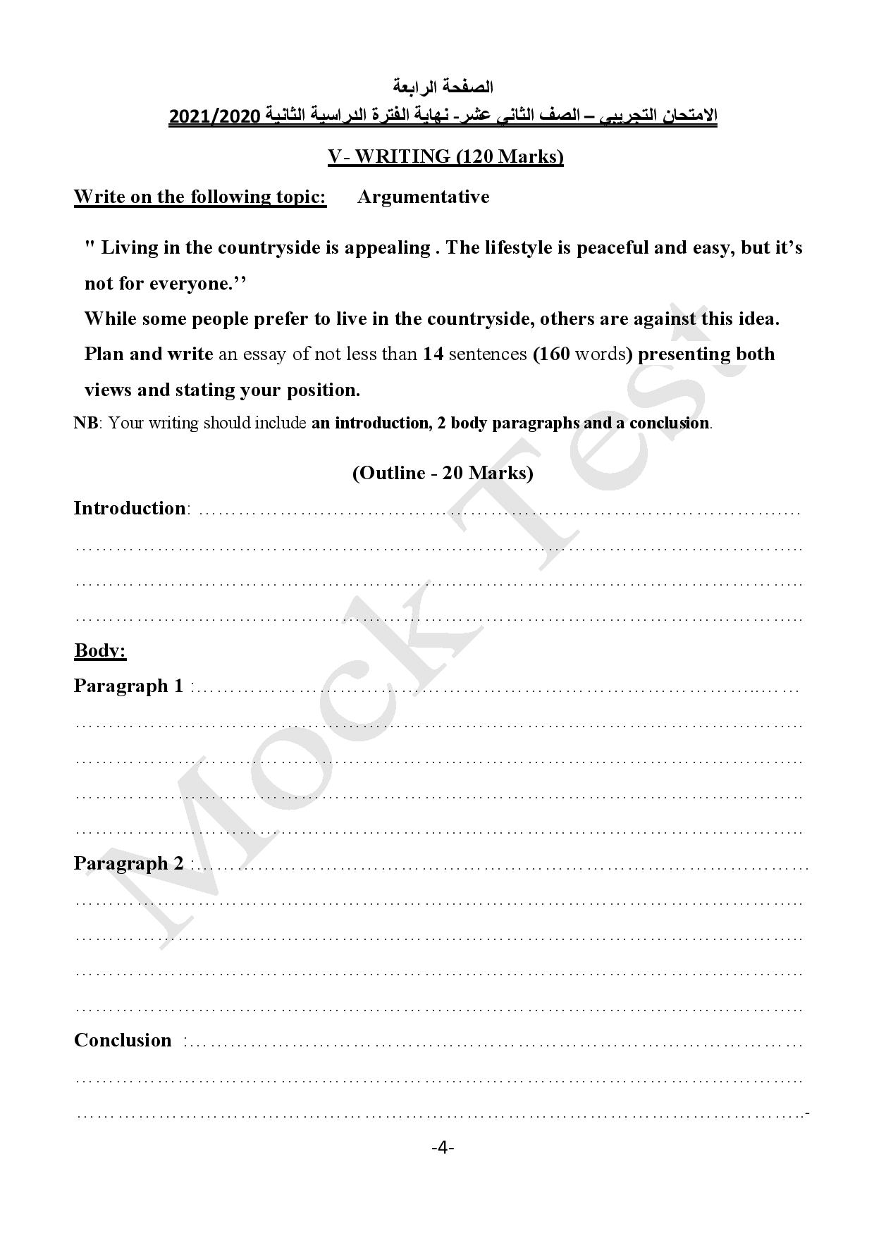

Slide 16
Living in the city and enjoying modern life and luxury isn’t everyone’s dream.
Some people prefer living in the village and want their life to be simple and easy-going. On the other hand, others opine that village life is boring and move to live in cities.
People who are for living in villages
grow their own food
village life is quiet
enjoy the fresh air
enjoy good health and peace of mind
there are many greenery places
see our national customs and traditions clearly
People who are against living in villages
farming has become less profitable
boring life for young people
not enough entertainment places
better services in cities
poor infrastructure in villages
To sum up, I think the living conditions in the village can be better so as to reduce the rate of rural depopulation. That can be achieved by providing villages with the suitable facilities.

Slide 19
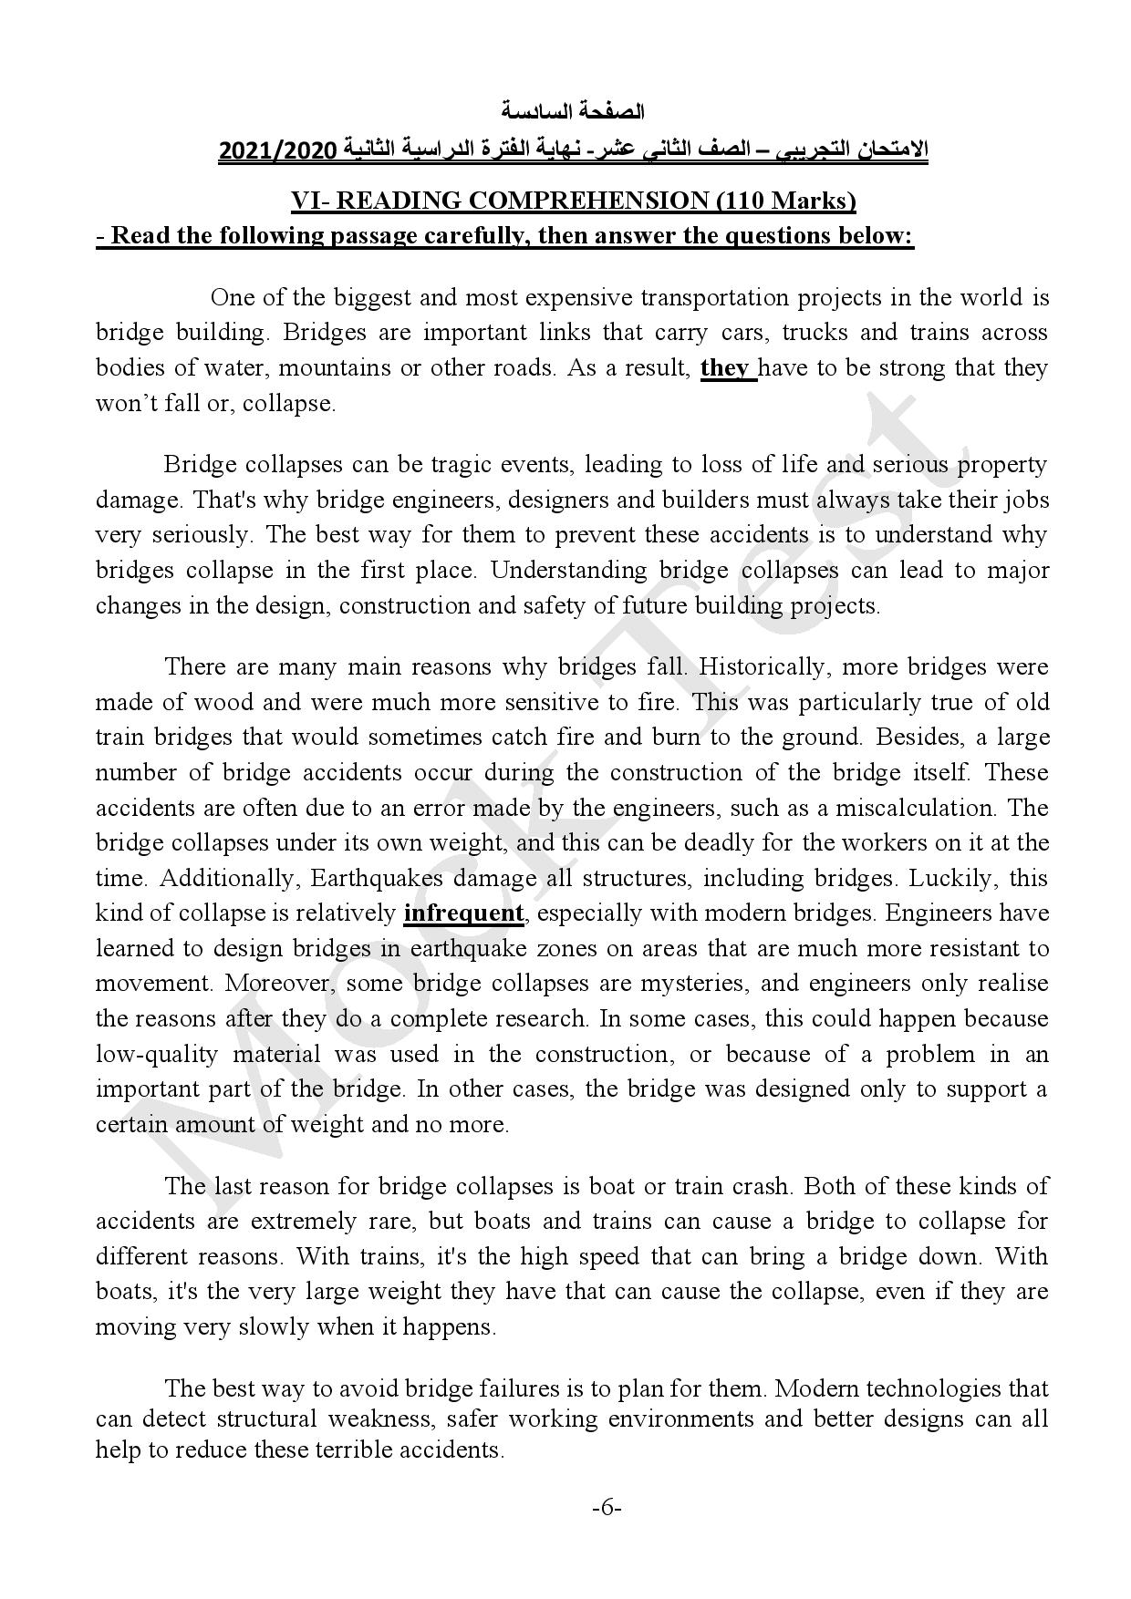

Slide 22
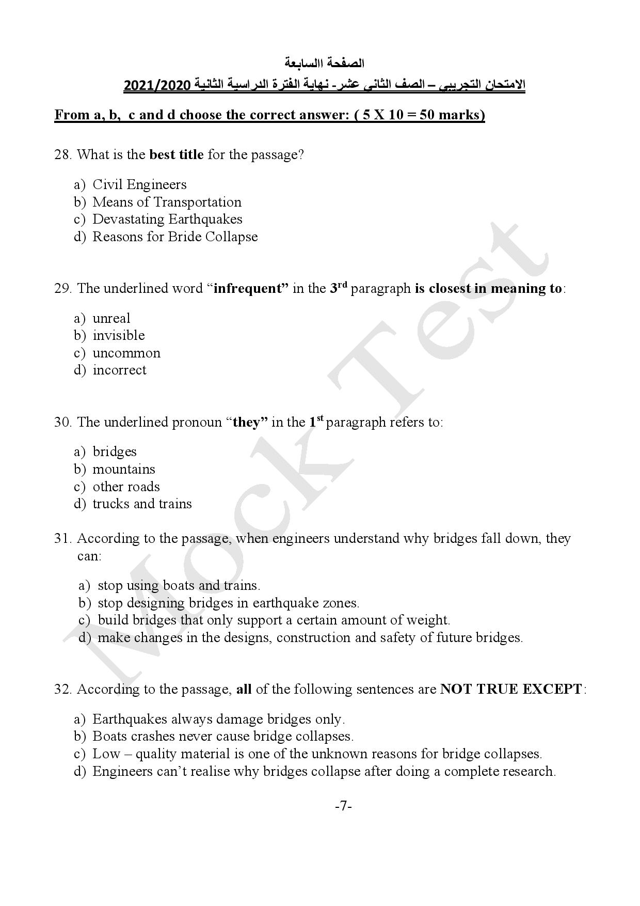
Bridge

Slide 23
Engineers can't realise why bridges collapse before doing a complete research.

Slide 24
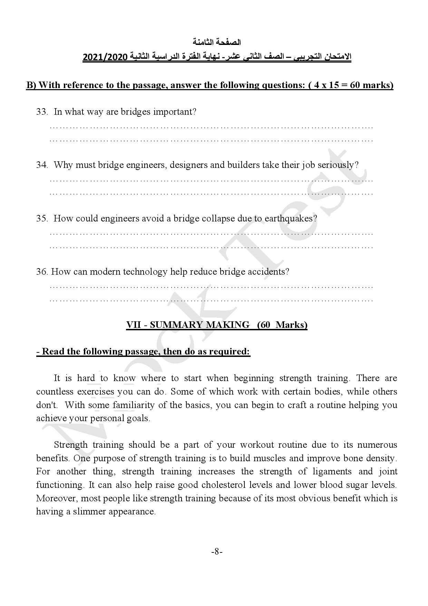
Bridges are important links that carry cars, trucks and trains across bodies of water, mountains or other roads.
Because bridge collapses can be tragic events, leading to loss of life and serious property damage.
Engineers have learned to design bridges in earthquake zones on areas that are much more resistant to movement.
Modern technology can detect structural weakness.

Slide 25
Rubrics of the summary making question
Content / relevance of ideas | Paraphrasing | Spelling & grammar | Paragraph format | Total
30 | 20 | 5 | 5 | 60
Does the summary contain the information written in the original text?
Has the SS used their own words?
Has the SS used and written the words correctly?
Has the student written a 4-sentence paragraph?
Copying the whole paragraph receives ZERO .
Remarks
Exceeding the required number of sentences:
Minus 5 marks for one sentence.
Minus 10 marks for two sentences and above.

Slide 26
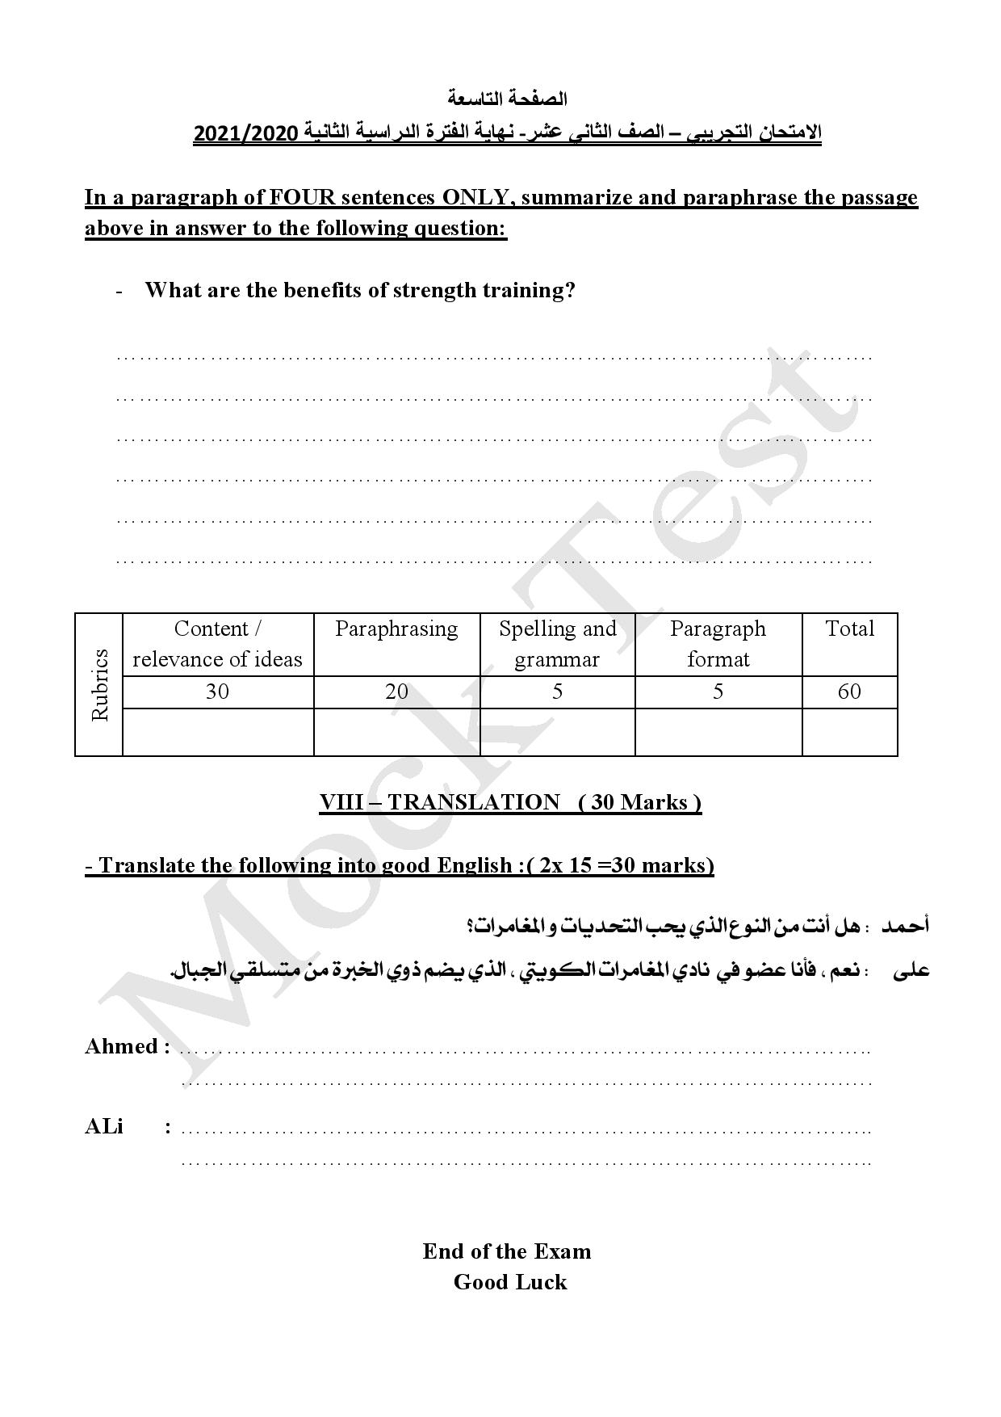
1
2
3
4

Slide 27
Let's paraphrase the highlighted sentences to answer the summary making question:
1
One purpose of strength training is to build muscles and improve bone density.
it helps in building your muscles and making your bones stronger.
Strength training increases the strength of ligaments and joint functioning.
it strengthens your joints and makes them function properly.
2
It can also help raise good cholesterol levels and lower blood sugar levels.
it can increase good cholesterol levels and decrease sugar levels in your blood
3
4
its most obvious benefit which is having a slimmer appearance.
it helps you to have a fit and slim body.

Slide 28
There are many benefits for strength training, first, it helps in building your muscles and making your bones stronger. Moreover, it strengthens your joints and makes them function properly. Furthermore, it can increase good cholesterol levels and decrease sugar levels in your blood. Finally, it helps you to have a fit and slim body.

Slide 29
Are you the kind of person who likes challenges and adventures?
Sure, as I am a member of the Kuwaiti Adventure Club, which includes experienced mountain climbers.

